Slide 1


Slide 2
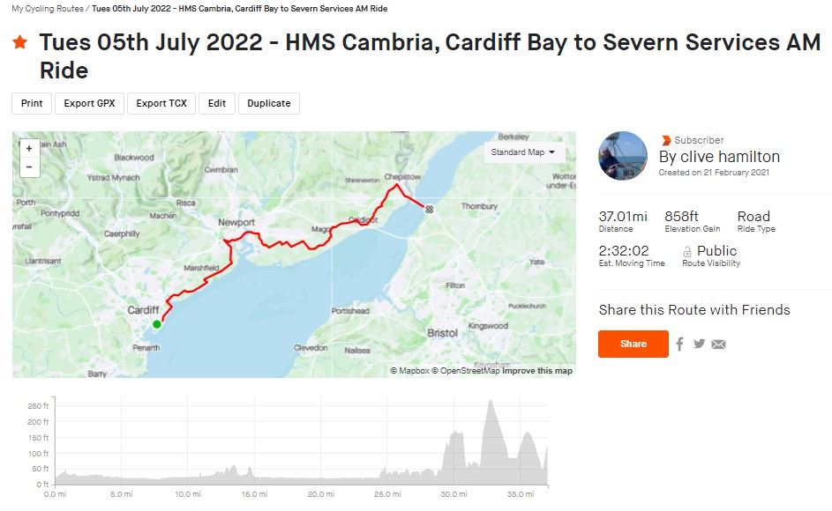


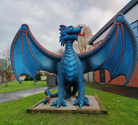
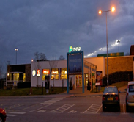
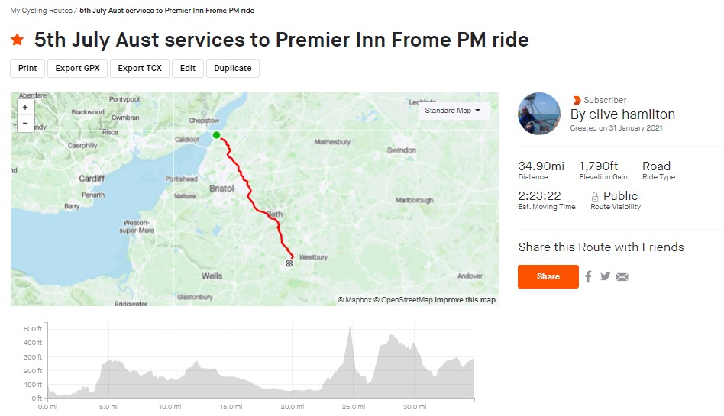
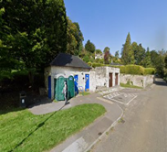


Expected Routes of the Ride broken down
Day 1 – Tuesday 05th July 2022
Meet between 07.00 hrs. & 08.00hrs.
Stow luggage in relevant vehicles
Group Photo & few departing words
Set to leave by 08.30hrs.
Tough day in saddle to day – C:75 miles
First stop will be Spytty Park Leisure Centre C:20 miles in
Lunch stop will be in the car park of the Moto services on the 1st Seven Crossing C:19 miles after stop one
Afternoon stop will be C:19 miles in at The Shallows, Saltford, Bristol BS31
Then on to Premier Inn, Frome C:17 miles
Do your “cycling admin”, stow the bike shower, change & organise a meal for yourself in the Beefeater next door.
Approximately 20.00hrs. The Captains will address us all with a briefing of the day and what's to be expected on Day 2 followed by an hour of Bingo

Slide 3
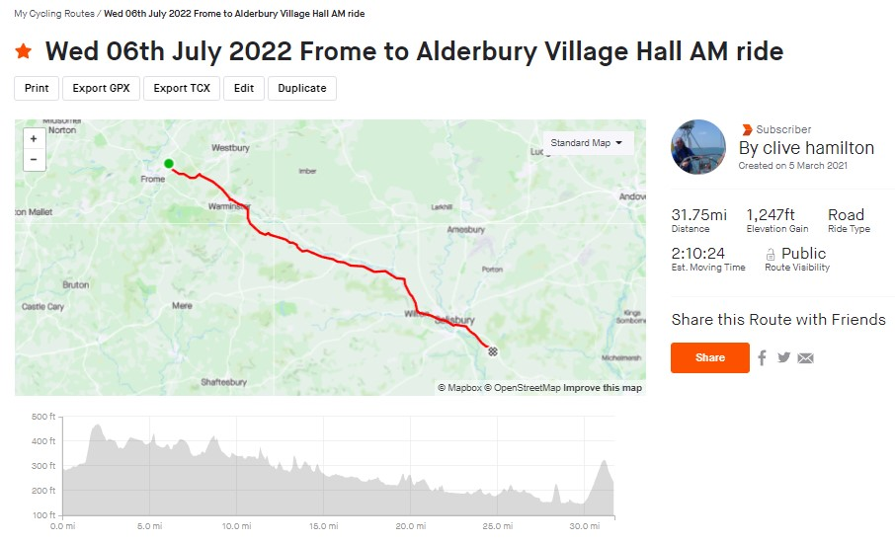
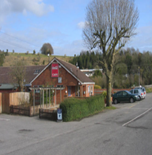
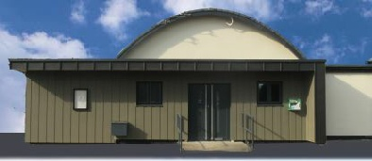
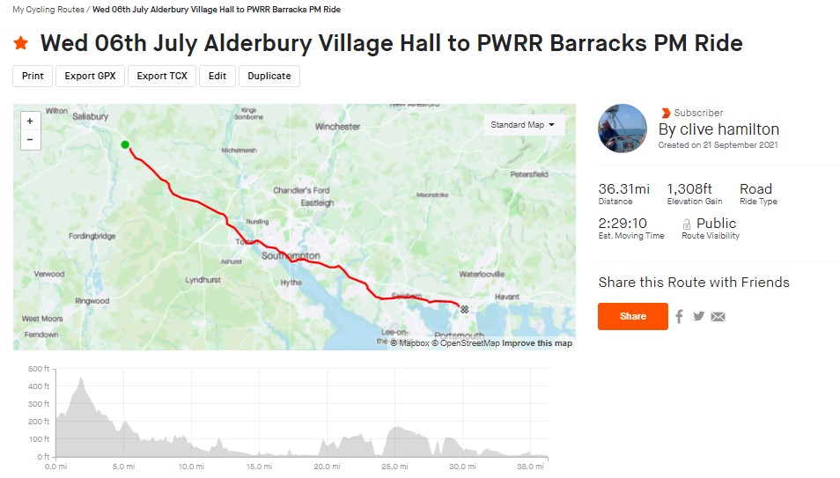


Day 2 – Wednesday 06th July 2022
Setting off after breakfast at approximately 09.00hrs.
Another long day in the saddle today with C:69 miles
Teams will depart staggered this morning with people fitting in to group`s 1,2 or 3
First stop will be C:15 miles at the Hillside Café, Codford
Followed by lunch stop at Alderbury Village Hall C:19 miles on
An afternoon stop C:18 miles in
Then on to 4 PWRR Barracks C:17 miles to the end
Sow all bikes safe and secure, grab a wash/shower & change with an over night bag containing your bike stuff for Day 3.
We then head out on the minibuses to the Ferry Terminal, collect tickets then visit the Ship & Castle for a well earnt pint and a warm meal.
At approximately 21.00hrs. We head over to terminal, check in and get ready to board the ferry.
When on board go and get your Cabin keys with your room mates and see you in morning…..

Slide 4
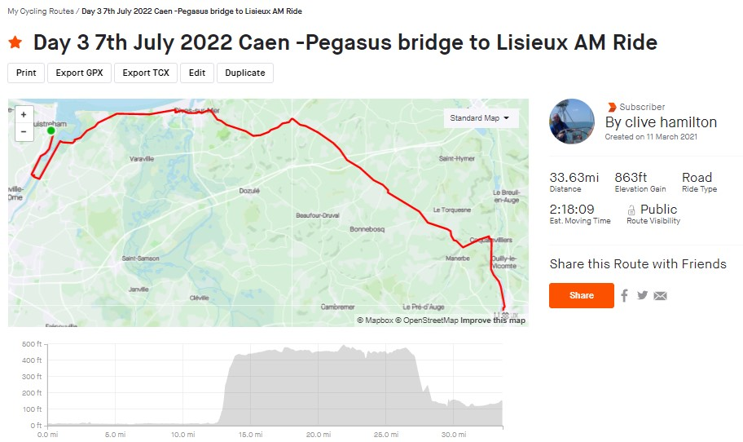


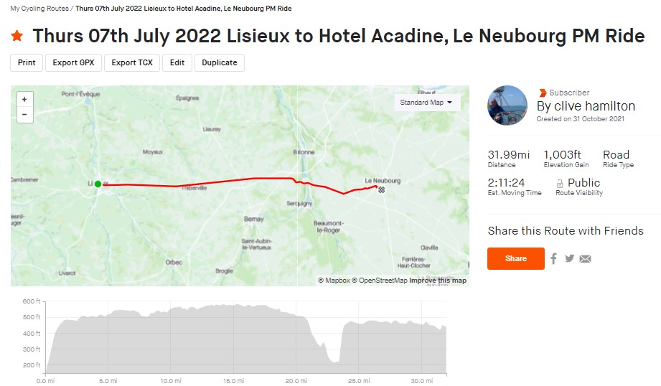

Day 3 – Thursday 07th July 2022
When we are approaching the port, the canteen opens where I suggest you grab a juice a quick bowl of cereals
On docking we all dis-embark as foot passenger ready to get on bikes (but with trainers on not cleats!).
When through Passport control, we will meet the support wagons in the car park of the ferry terminal where we will all unload our bikes, make sure they are in good order , stow the overnight bag and put the cycle bag in the relevant support van
We all leave together this morning travelling C:4 miles to Pegasus Bridge Memorial where we will pay our respects to the fallen and remember the sacrifice in WWII
After a breakfast stop in the café`s on the Bridge we then re-group and cycle C:16 miles to our first stop (TBC)
Lunch will be in a village called Lisieux which will be C:14 miles further
After lunch we head toward Le Neubourg some 32 meals away where we will stop at C:16 miles for a break and again some C:4 miles out from the hotel to sample some French delights….
We then travel together complete our “cycle admin” before checking in, freshening up, enjoying a meal ready to meet…
Captain night this evening = Karaoke after the briefing

Slide 5
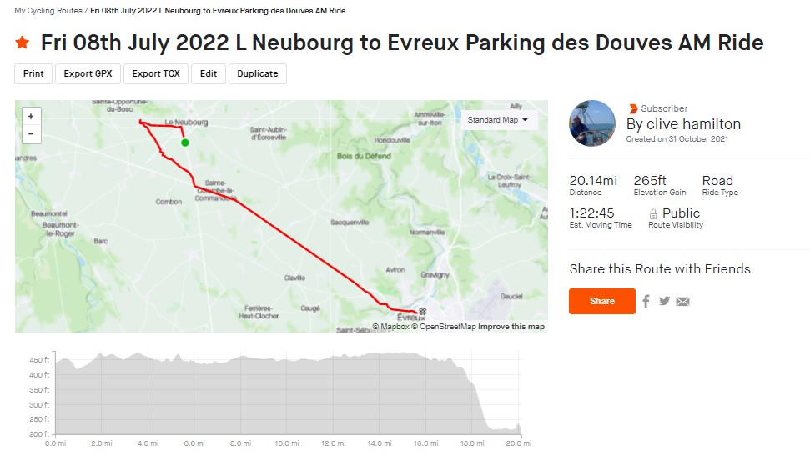



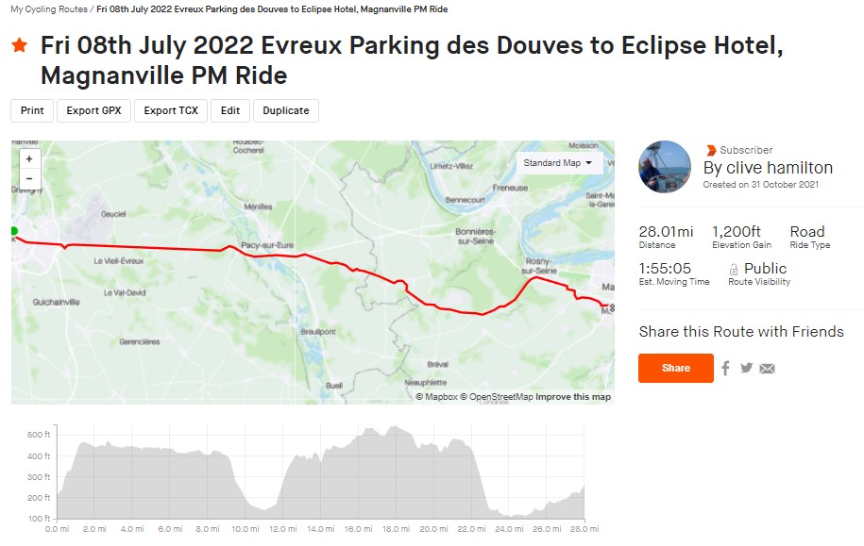

Day 4 – Friday 08th July 2022
Setting off after breakfast at approximately 09.30hrs.
Again, all together this morning for the first 4 miles as we travel to the local Commonwealth War Grave to pay our respect and thanks to one Captain Burgess of the Royal Artillery who sadly lost his life in WWII at 28 years young on Aug. 26th, 1944
After our service we will make our way down to a town called Evereux which is C:20 miles away for lunch stop; stopping after about 10 miles for a break
After lunch we had across country to a town called Mantes La Ville in Magnanville which is C:24 miles away, stopping at about 20 miles to taste the local hospitality before riding to the hotel all together
Do your “cycling admin”, stow the bike shower, change & organise a meal for yourself in one of the many cafes/restaurants locally
We will be meeting back at hotel at 20.00hrs. For Captains brief which will be followed by a short Captains quiz to determine how much knowledge you`ve gained about the trip so far.. ☺

Slide 6
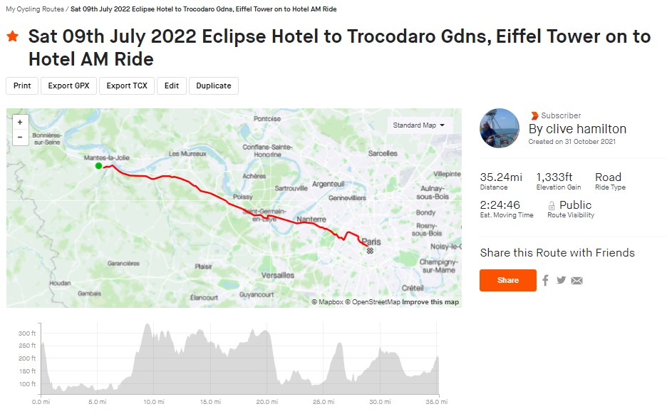


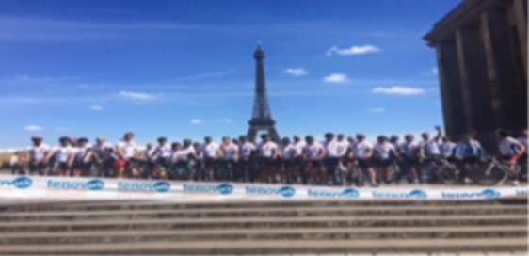


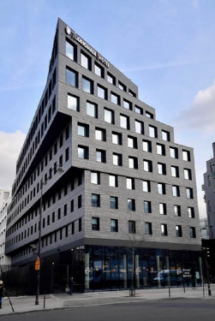

Day 5 – Saturday 09th July 2022
Setting off after breakfast at approximately 09.00hrs.
Together we will ride as a group the C:3 miles to Commonwealth War grave Cemetery in Mantes-la-Jolie to pay our respects to the fallen of WWI where particularly we will remember two young Welsh Fusiliers from the Welsh Regiment who sadly crossed the bar in the Great War. 43840 Private H. Jones, 11th Bn. Welsh Regiment, died 19th June 1918 & 15560 Private H. Warwick, 11th Bn. Welsh Regiment, died 19th June 1916
We then head to Paris C:31 miles to the Eiffel Tower & the Trocadero Gardens where we will have the obligatory photo shoot and celebrations. The wagons along with all vans apart from 2 support vehicles will head to the Hotel car park ready to greet us. There won't be any lunch today however we will stop at C:15 miles and again C:2 miles out of the end point so we can ride in as a group
We will then ride as a group between the 2 vehicles the C:4 miles to the Hotel Maison Montmartre where we will stow and pack bikes away, check in and shower, change and have the afternoon at your leisure.
We ask that all main luggage is packed onto wagons by 17.30hrs. With only the overnight bag remaining . We will then all meet for a deserved few celebratory drinks and the Captains de-brief of the trip.
18.30hrs. The awards ceremony will take place on the Rooftop Cocktail Bar and Restaurant where after this we will have a Gala Meal reflecting on what we have achieved both for yourselves but for Woody`s Lodge as well.

Slide 7















Day 6 – Sunday 10th July 2022
Support Drivers & Vehicles_______________
Support Drivers will leave C:09.30hrs. To head to Calais – Eurotunnel terminal
Check in at C:12.55hrs for 13.20hrs. Depart
Arrive in Folkstone and dis-embark at C:14.00hrs.
This will give them plenty of time to safely get to HMS Cambria by the 19.30/20.00hrs to meet the rest of us.
Riders & People flying home
Transport to Orly airport from the Hotel will take 45 mins, so we would need to ask you to be at airport for 16.45hrs ready to depart at 18.50hrs. No check in bags only on board luggage(1 bag)
We land in Bristol and 19.05hrs. And a bus will take us to HMS Cambria to meet support drivers for 20.00hrs.
Any support person or part time rider wanting to fly home must purchase their own flight ticket home on - Paris Orly to Bristol Flight number EZY6236. Departure 18.50hrs. Arrive 19.05hrs.

Slide 8
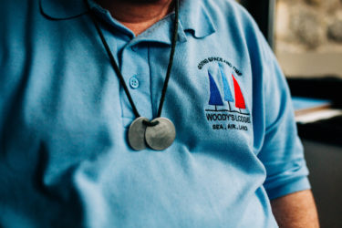
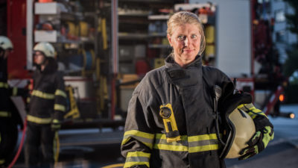

What Does Your Money Help With?
Veterans & Emergency Services Drop-in Centre's in
    South Wales / West Wales & North Wales
Assists with the welfare of these people in our communities
Support the NHS by working with & supporting referrals
Assist with the homeless Veterans by supporting them with housing & employment engagement
Providing a safe and easy place for them to come & re-engage with society by offering a social venue and a supporting shoulder
Working with the Police Forces & Prison Service to advise, support and rehabilitate our Veterans when they need be put back on to the right track
Supporting the Partners, Wives & Children that are lost in society when returning to the communities
Supplying a safe and quiet place for Families to re-engage with themselves
Assisting our Veterans , NHS Trusts & Emergency Services by supporting those that are suffering from dementia
Plus, so much more….
Small Enough to Care, Big Enough to Cope……………..

